Slide 1
Different Collaborative Filtering Algorithms in Recommendation System
Presenters: Liyi Cao, Yimeng Wang, Yu Zhao
Github link: https://github.com/YuZ1225/BU-EC503-Project-Fall-2018

Slide 2
01
Introduction
02
Dataset and Evaluating Metric
CONTENTS
03
Memory-based CF
04
Model-based CF
05
Result and Conclusion

Slide 3
Introduction
01
Introduction of recommendation system and collaborative filter

Slide 4
Recommendation System
Purpose
1. information filtering system
2. predict the "rating" or "preference" a user would give to an item
Significance
1. Quickly find what we want to know
2. avoid information overload
Types
1. content-based recommendation system
2. collaborative filter
Notes:
In fact, the recommendation system is an information filtering system. Its purpose is to predict the "rating" or "preference" a user would give to an item. So It can help us quickly find what we want to avoid overloading information. The recommendation system is mainly divided into two types. One is content-base and other is called collaborative filtering algorithm, which is more widely use. We used collaborative filter in our project.

Slide 5
Collaborative Filter
It is to use the preferences of a group with similar interests and common experience to recommend information of interest to users.
1. Memory-based
1.1 User-based (Neighbor-based Collaborative Filtering)
1.2 Iterm-based
2. Model-based
Various kinds, such as models based on Bayesian, model based on matrix
factorization and so on.
3. Hybrid collaborative filtering
Combine collaborative filter with content based recommendation system.
Difficulty：Matrix sparsity...
Notes:
memory-based finds the most similar k users/items through the calculation of similarity, and then recommends according to these.
The biggest difficulty in collaborative filtering is the sparsity of the matrix.

Slide 6
Dataset and Evaluating Metric
02
we use the Book Recommender: Collaborative Filtering, Shiny by Philipp Spachtholz from kaggle.
the link is: https://www.kaggle.com/philippsp/book-recommender-collaborative-filtering-shiny/data

Slide 7
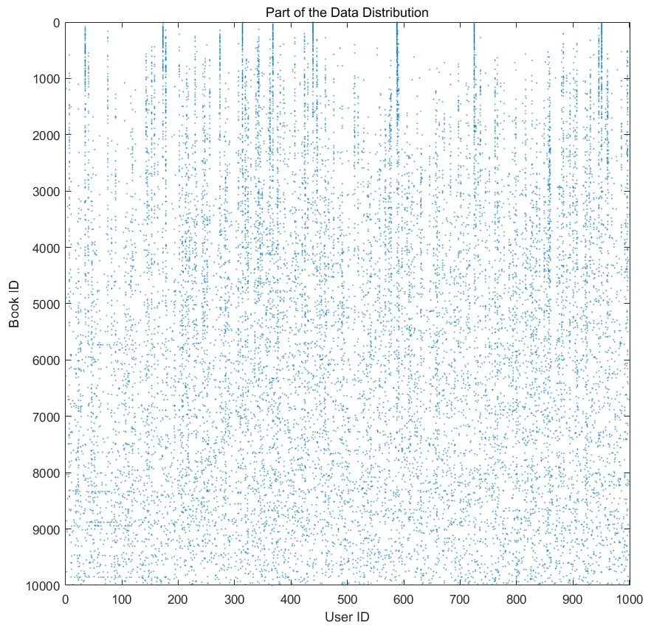
Dataset
10k*50k, 981756 ratings, sparsity 99.82%
For observed data of each book:
Mean: 97.9478
Std: 5.7593
For observed data of each user:
Mean: 18.3340
Std: 26.2246
Min: 1
Max: 200
Rating | 1 | 2 | 3 | 4 | 5
Number | 19575 | 63231 | 248623 | 357366 | 292961
Percent | 1.99% | 6.44% | 25.32% | 36.40% | 29.84%
Notes:
But only less than one million rating data.The range of ratings is from 1 to 5. The most rated is 4, and rating 1 and 2 are very few. Through data observation, we can conclude that the standard deviation of each book is small, but the books rating by each user are very different. The smallest one has only evaluated one, and the largest has 200.

Slide 8
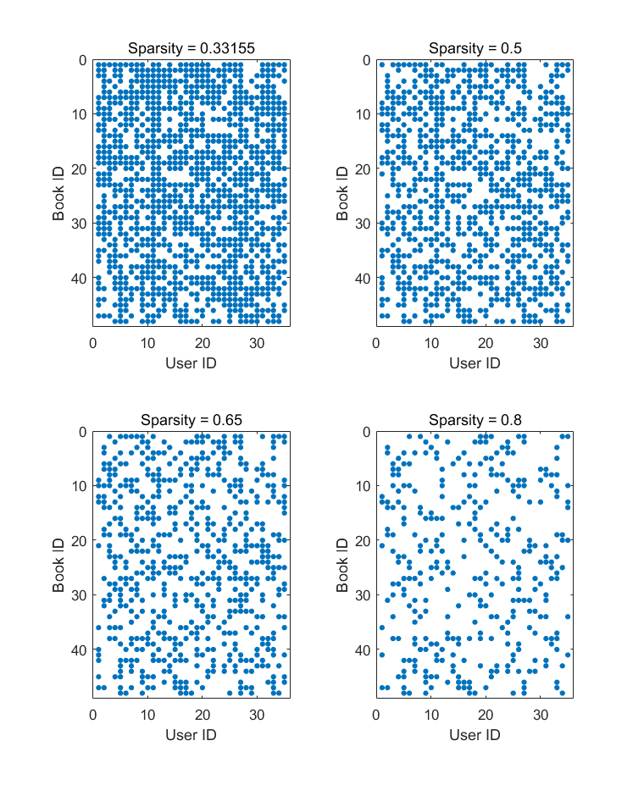
Extracted Small Dataset
48*35, 1158 ratings, sparsity 31.07%
Make 10 small datasets with sparsity from 35%-80%
Rating | 1 | 2 | 3 | 4 | 5
Number | 25 | 63231 | 248623 | 357366 | 292961
Percent | 2.16% | 6.22% | 21.42% | 36.01% | 34.20%
Notes:
Because the original matrix is too sparse, we extracted a small matrix from it. It is 48*35 matrix. The distribution of rating is basically the same as the original data. The sparseness of the matrix has been continuously increased by 5 percent each time from 35 percent to 80 percent with a total of 10 data sets.

Slide 9


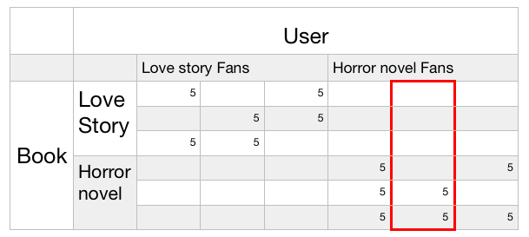
Evaluating Metric
MAE
RMSE/RMSD
* MNAR：instead of giving low rate, users tend to not given a rating at all
* Important conclusion：Rating are missing not at random.
Wikipedia contributors. (2018, August 28). Root-mean-square deviation. In Wikipedia, The Free Encyclopedia. Retrieved 21:12, December 9, 2018, from https://en.wikipedia.org/w/index.php?title=Root-mean-square_deviation&oldid=85693407
Notes:
From this matrix we can see that these two classes do not have any overlap. Now I need to predict this user’s rating for all books. To minimize MAE/RMSE, I can make one of the simplest hypothesis, all missing ratings for this user are assumed to be 5. But obviously, there are some problems with this hypothesis. The situation in the reality to that point is called MNAR. It means…

Slide 10
Baseline
Use the round value of overall mean rating, which is 4, to every user
Notes:
We made a baseline that make the all of the prediction with score 4, which is the average rating score of the whole dataset.

Slide 11
Memory-based CF
03
User-based CF Algorithm
Cosine similarity and Pearson correlation
Notes:
As mentioned above, Collaborative Filtering (CF) is a mean of recommendation based on users’ past behavior. There are two categories of CF: User-based:
Item-based:
In this project, we used the user-based Collaborative Filtering.

Slide 12
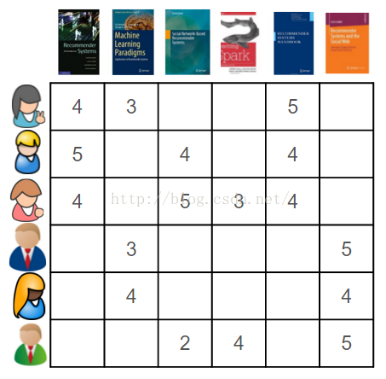
User-based Collaborative Filtering
The key idea behind CF is that similar users share the same interest and that similar items are liked by a user.
4 | 3 | 0 | 0 | 5 | 0
5 | 0 | 4 | 0 | 4 | 0
4 | 0 | 5 | 3 | 4 | 0
0 | 3 | 0 | 0 | 0 | 5
0 | 4 | 0 | 0 | 0 | 4
0 | 0 | 2 | 4 | 0 | 5
?
User matrix which includes one vector for each user.
Notes:
The key idea behind CF is that similar users share the same interest and that similar items are liked by a user. For example, there are 6 users who has rated for some of the 6 books. Then it would generate a matrix. Each row of the matrix is the user’s vector which record the ratings that the user has made.

Slide 13
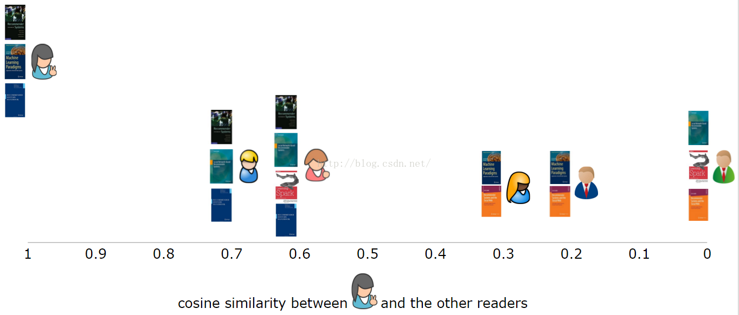

User-based Collaborative Filtering
Calculate the similarity of user1 with each other users.
Pick Top N similar users who have read the book and estimate how would the target user rating for that book.
?
Notes:
In this example, we want to estimate the how would the user1 would rate on the green book, which is the one that user1 has not read it. Firstly, we find all the users who has rated on this book. And we use the user vectors to calculate the similarities of each of these users with user1. Then, we pick top N similar users and get their ratings to the green book. And calculate the average or mode of these ratings to estimate how the user1 would rate on the book which user1 has never rated yet.

Slide 14
How to test the accuracy?
Choose a book that the target user has already rated. Pick Top N similar users who have also read the book and estimate how would the target user rating for that book (mode or average).
Notes:
To test if our model is accurate on estimating the ratings, here are the method that how we evaluate the model. We choose a book randomly that user1 has read and rated before. The we use the same method to estimate how would user1 rating for that book. And we will compare the predict rating and actual rating to calculate the MAE and RMSE of them.

Slide 15
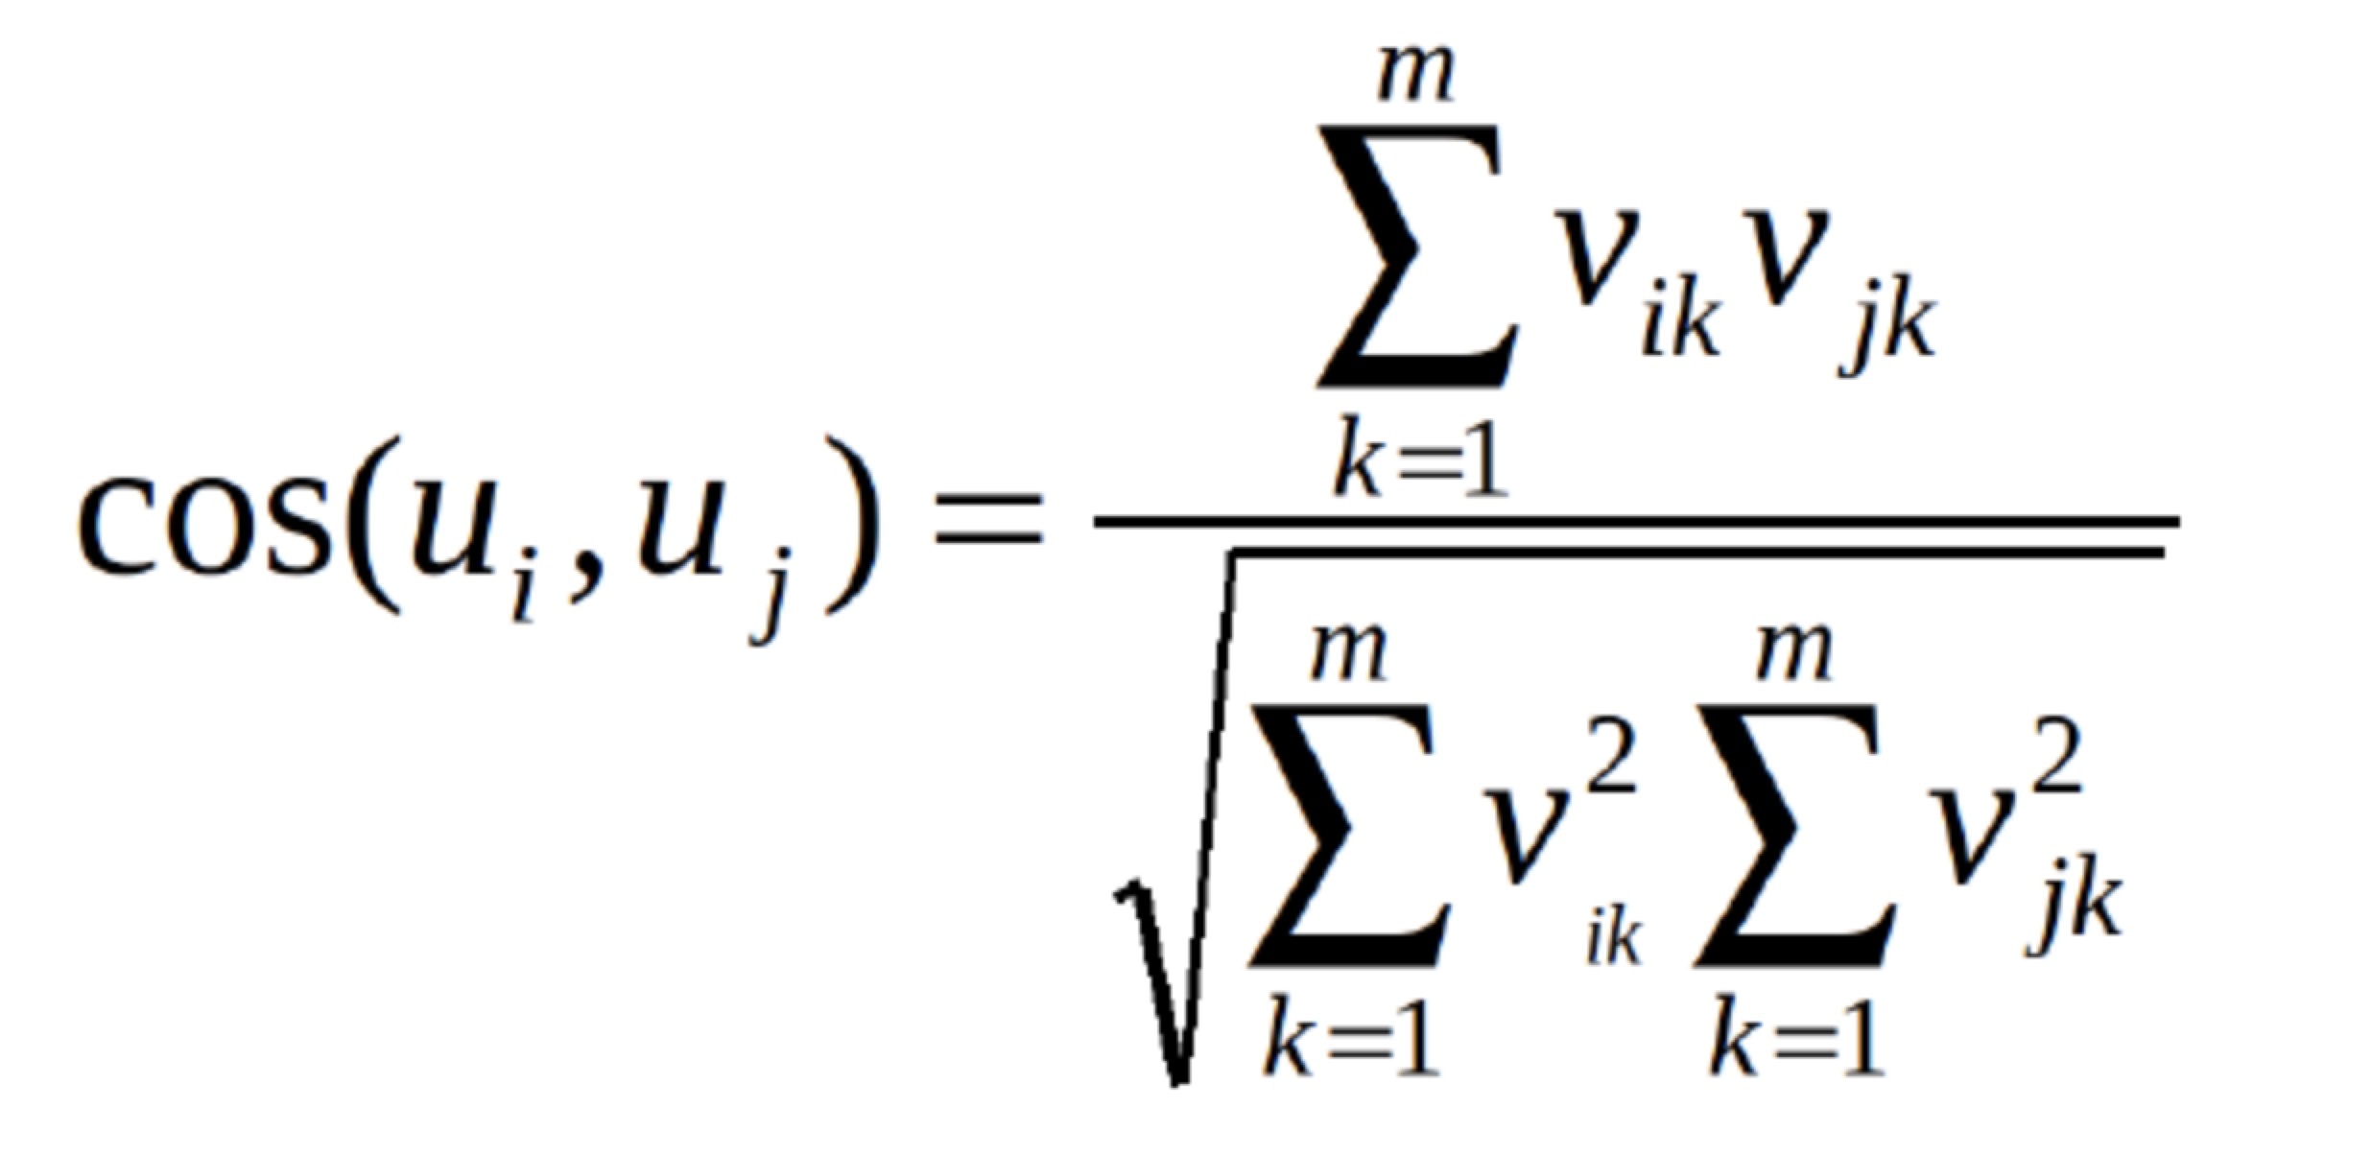
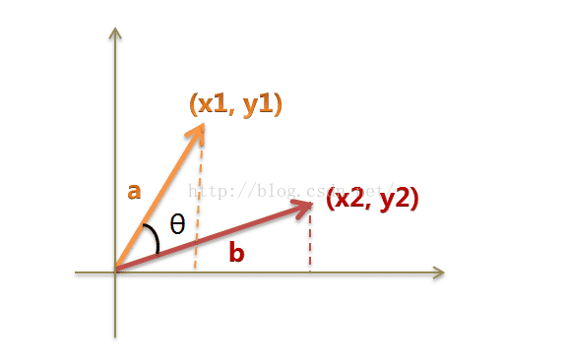
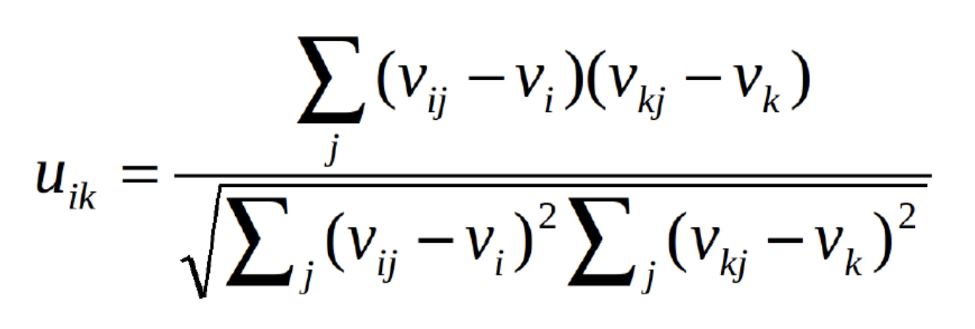
How to calculate the similarity?
Cosine Similarity:
MAE: 0.8260
RMSE: 1.1911
range: [-1,1]
Pearson Correlation:
MAE: 0.8575
RMSE: 1.1876
Notes:
In this project, we have tried 2 methods to calculate the similarity. One is Cosine similarity and the other one is Pearson similarity. Both measures are commonly used. Both of them has the range from -1 to +1. The two users’ similarity is closer to +1, they are more similar. The difference is that Pearson Correlation is invariant to adding a constant to all elements. For cosine similarity, we got a MAE around 0.83, RME around 1.19. And for the Pearson Correlation, we got a MAE around 0.86 and RMSE around 1.18.

Slide 16
Problems of user-based CF Recommendation System
Users’ preference can change over time, which indicates that precomputing the matrix based on their neighboring users may lead to bad performance.
Sparsity is another concern.
0 0 3 0 0 0
0 0 0 0 0 0
0 0 5 0 0 0
0 0 0 0 0 0
0 0 0 0 0 0
0 0 3 0 0 0
Notes:
Although computing user-based CF is very simple, it suffers from several problems. One main issue is that users’ preference can change over time. It indicates that precomputing the matrix based on their neighboring users may lead to bad performance. The other is the high sparsity of the matrix with a large amount of users and books. This is a little part of our dataset, which has a high sparsity. That means 2 users who are not similar but may got a high similarity, which would lead to a bad result, too. Later my teammate will explain how we solve this kind of problem by Matrix Factorization.

Slide 17
Model-based CF
04
Naive Bayes CF & Probabilistic Matrix Factorization

Slide 18
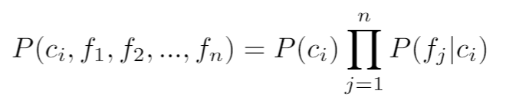
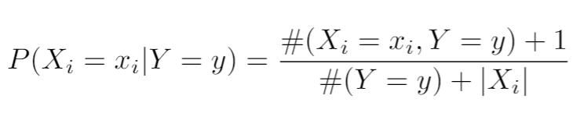
Naives Bayes CF
Use the Naives Bayes classifier.
Assuming the feature are independent given the class.
To deal the condition that a conditional probability is 0, we use the Laplace Estimator.

Slide 19
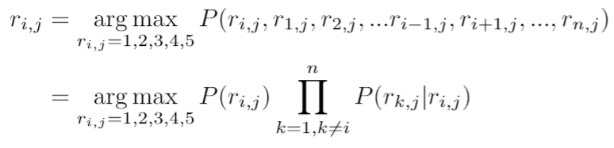
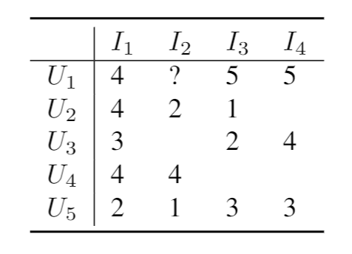
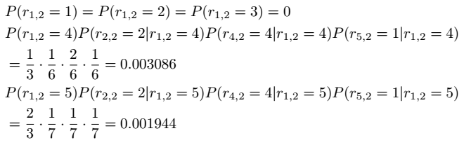
Naives Bayes CF
e.g. suppose we are going to predict the rating of user i on item j. k stands for other users.

Slide 20
Probabilistic Matrix Factorization
Factorize the (unknown) complete rating matrix R^{mxn} two matrix U^{mxd} and V^{nxd}:
R = U * V^{T} ( + r_{m})
r_{m} is the rating offset of missing data
d is the number of latent features.
r_{m}+
R
m x n Matrix
U
m x d Matrix
V^{T}
n x d Matrix

Slide 21

Probabilistic Matrix Factorization
Using the PMF model, the problem becomes an optimization of least square problem:
Parameters:
R^{o&i}: observed and missing rating matrix
U,V: item and user matrix with latent features
W: weight matrix
d: number of latent features
r_{m}: imputed rating offset
ƛ: regularization parameter
Notes:
Matrix Factorization for Movie Recommendations
https://www.youtube.com/watch?v=aKQfUbxU96c

Slide 22

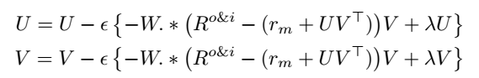
Probabilistic Matrix Factorization
Use the gradient descent to solve the problem:
For each iteration:
* To initialize U and V, we need to make them random at the beginning.
* U = ( (1 + 1 * randn(d, m)) * 1/sqrt(d/3) )';
* V = ( (1 + 1 * randn(d, n)) * 1/sqrt(d/3) )';

Slide 23
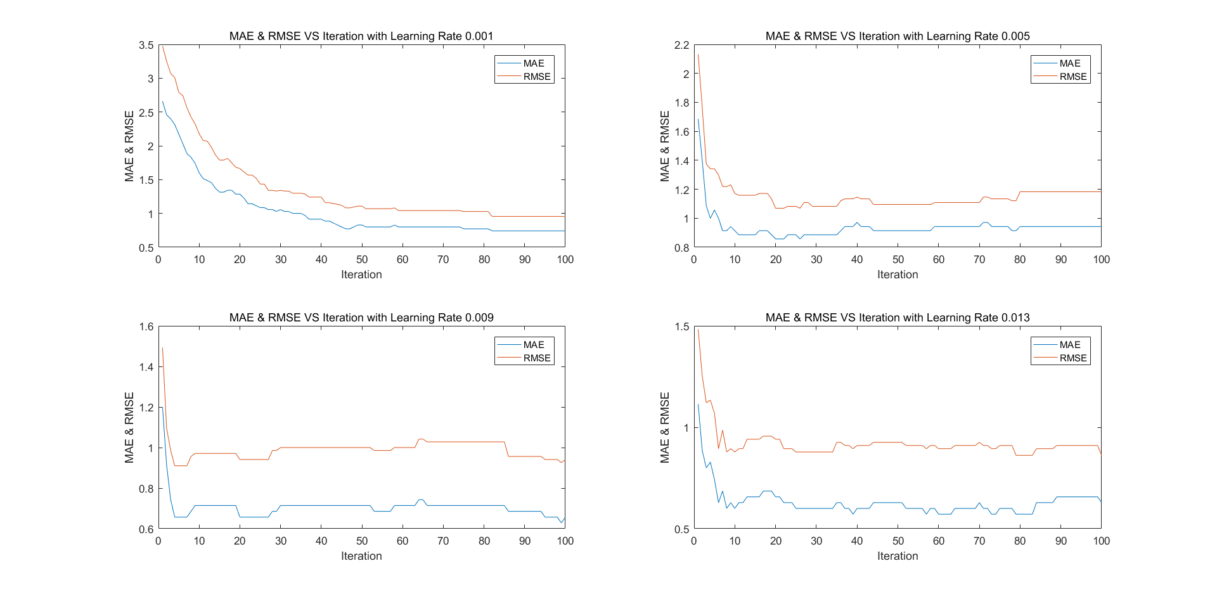
Probabilistic Matrix Factorization
Optimize learning rate ε
Default:
iteration = 100
W_{m} = 0 (Indicator Matrix)
r_{m} = 0
d = 3
ƛ = 0.01

Slide 24
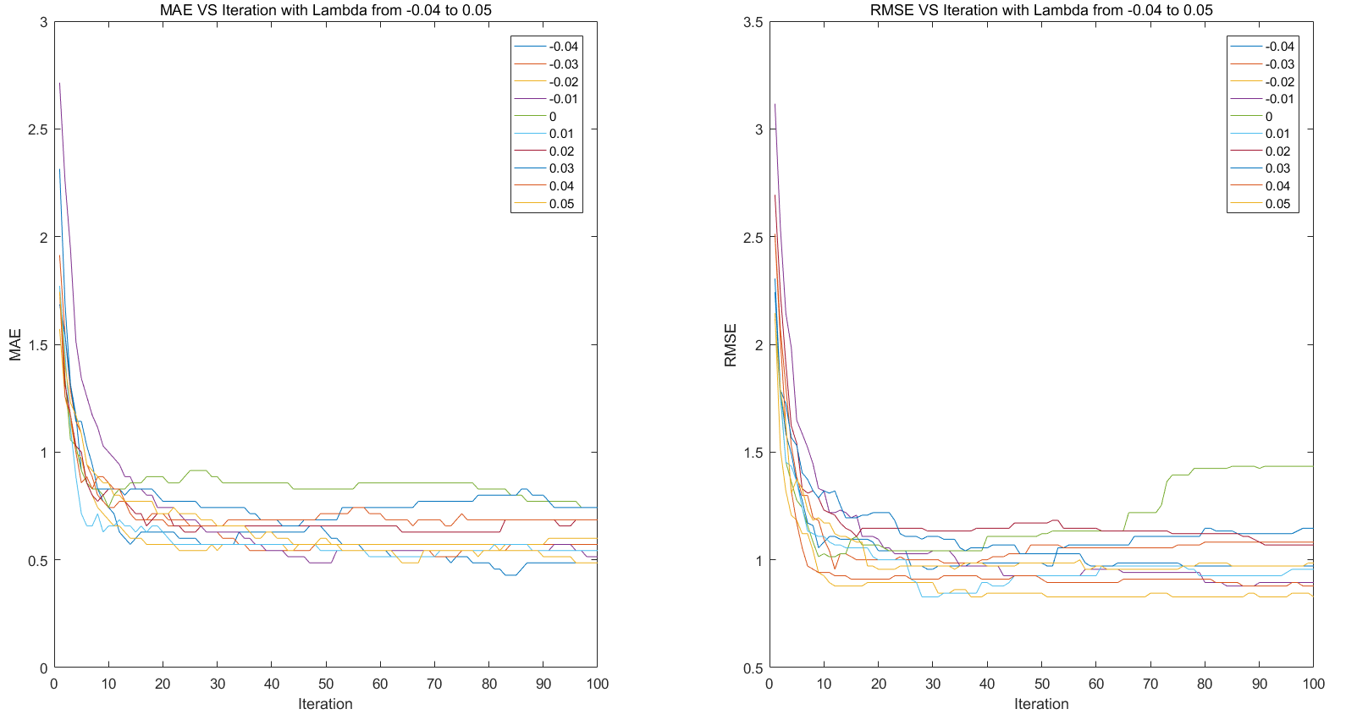
Probabilistic Matrix Factorization
Optimize ƛ: -0.04 to 0.05
Default:
iteration = 100
W_{m} = 0 (Indicator Matrix)
r_{m} = 0
d = 3
ε = 0.001

Slide 25
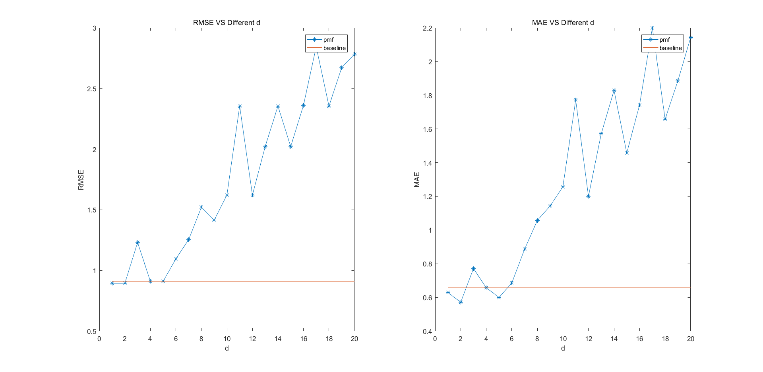
Probabilistic Matrix Factorization
Optimize d: 1 to 20
Default:
iteration = 30
W_{m} = 0 (Indicator Matrix)
r_{m} = 0
ε = 0.005
ƛ = 0.01

Slide 26
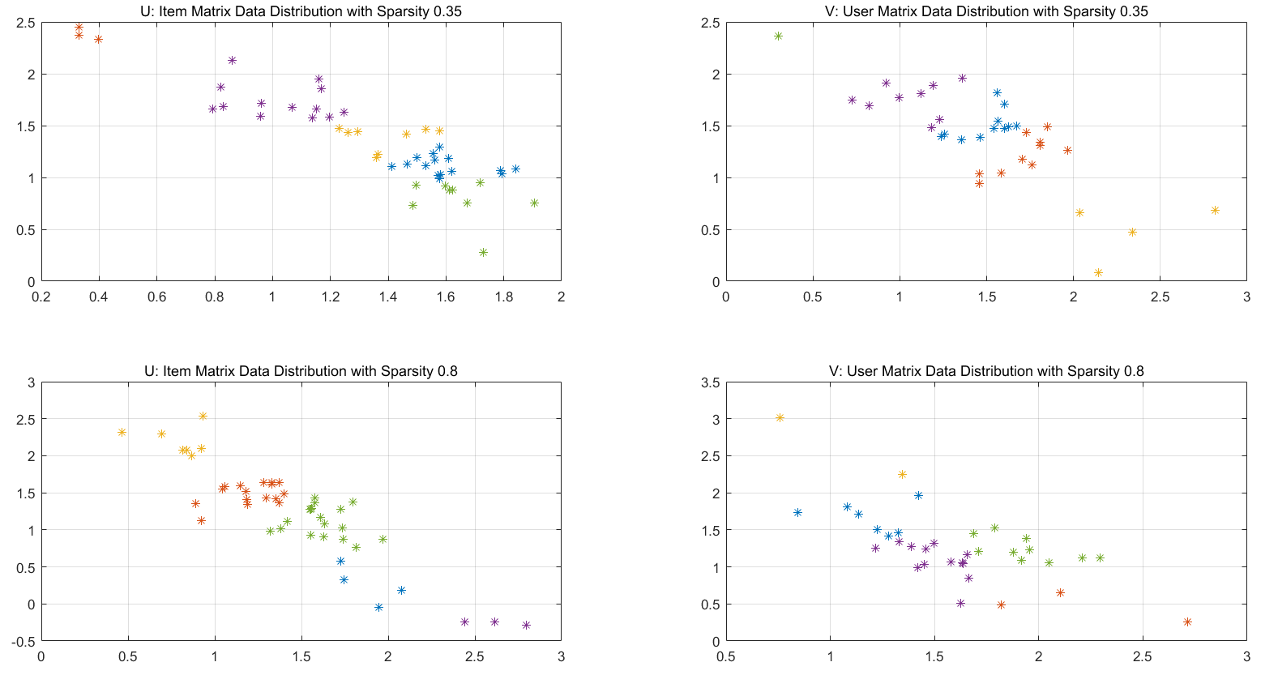
Probabilistic Matrix Factorization
Visualize small datasets’ U and V matrix in 2d

Slide 27
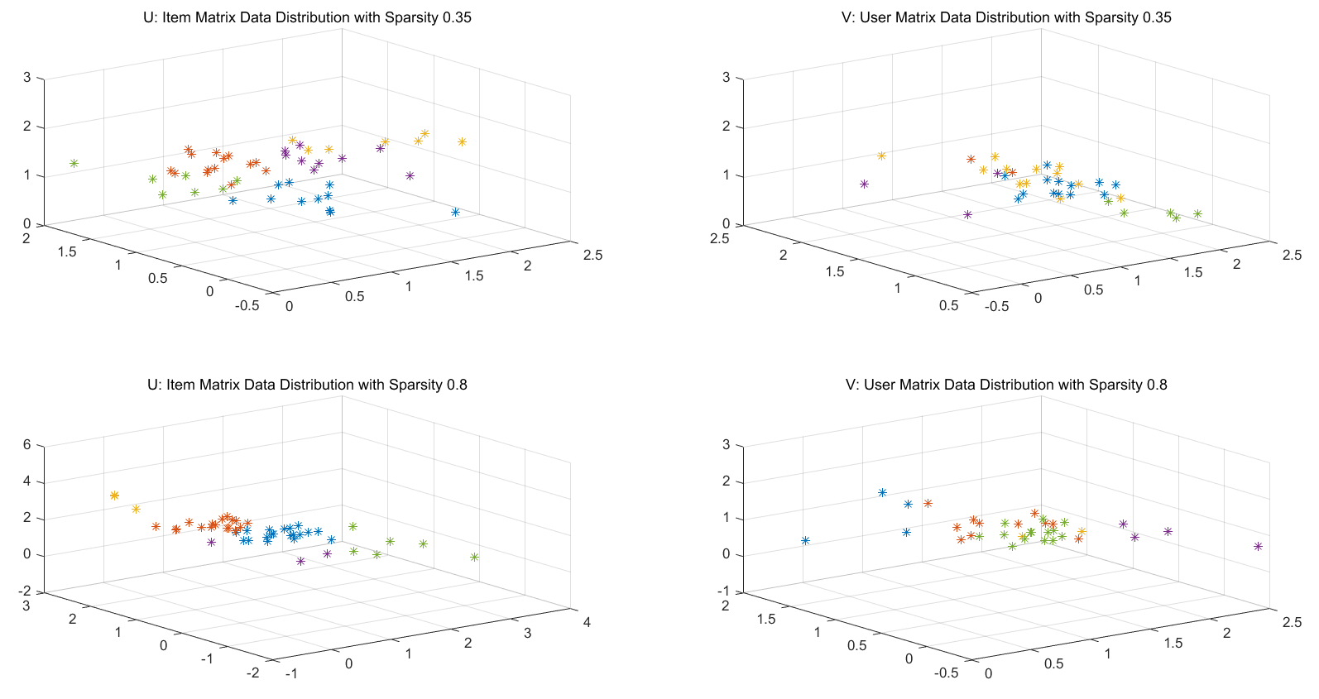
Probabilistic Matrix Factorization
Visualize small datasets’ U and V matrix in 3d

Slide 28
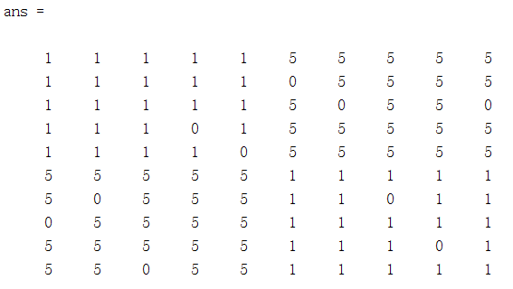
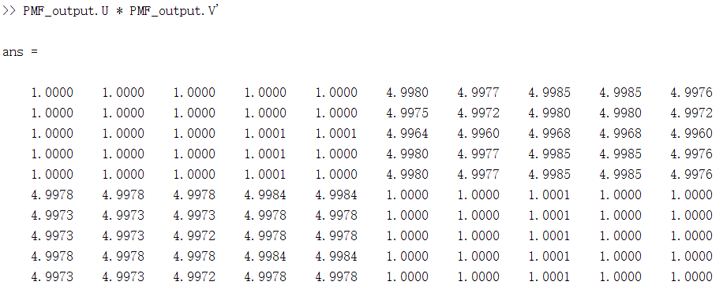
Probabilistic Matrix Factorization
Typical Dataset:

Slide 29
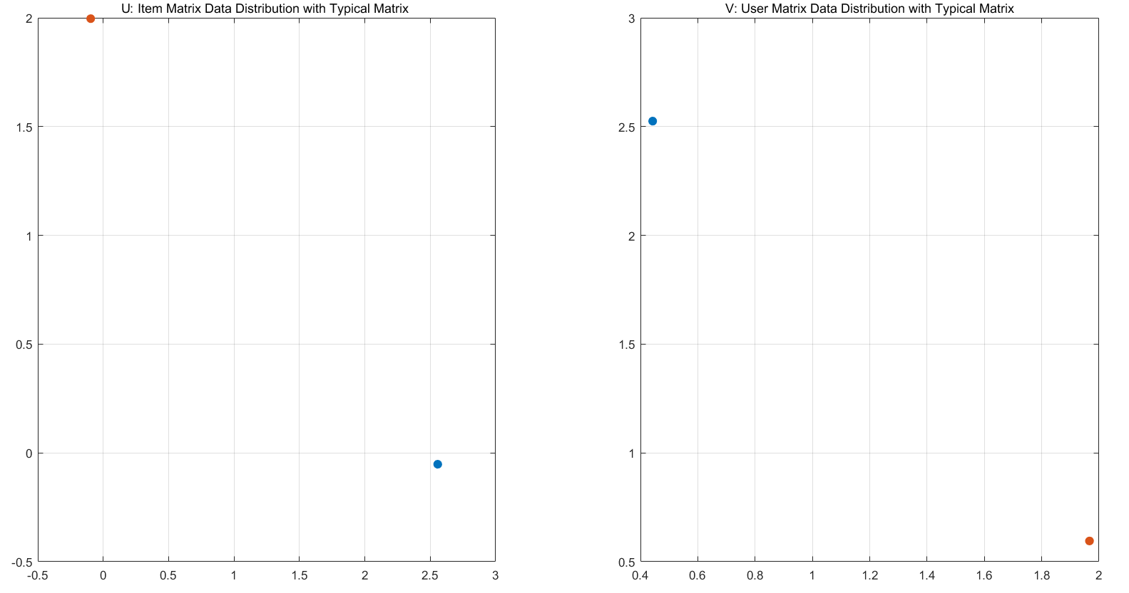
Probabilistic Matrix Factorization
Visualize typical dataset’s U and V matrix in 3d

Slide 30
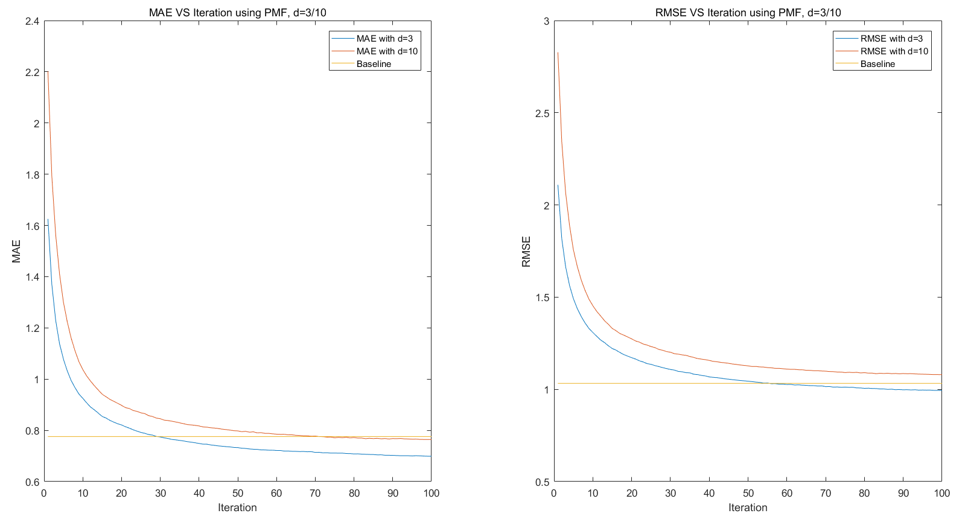
Probabilistic Matrix Factorization
Learning entire dataset:
Default:
iteration = 100
W_{m} = 0 (Indicator Matrix)
r_{m} = 0
ε = 0.003
ƛ = 0.01
d = 3 or 10

Slide 31
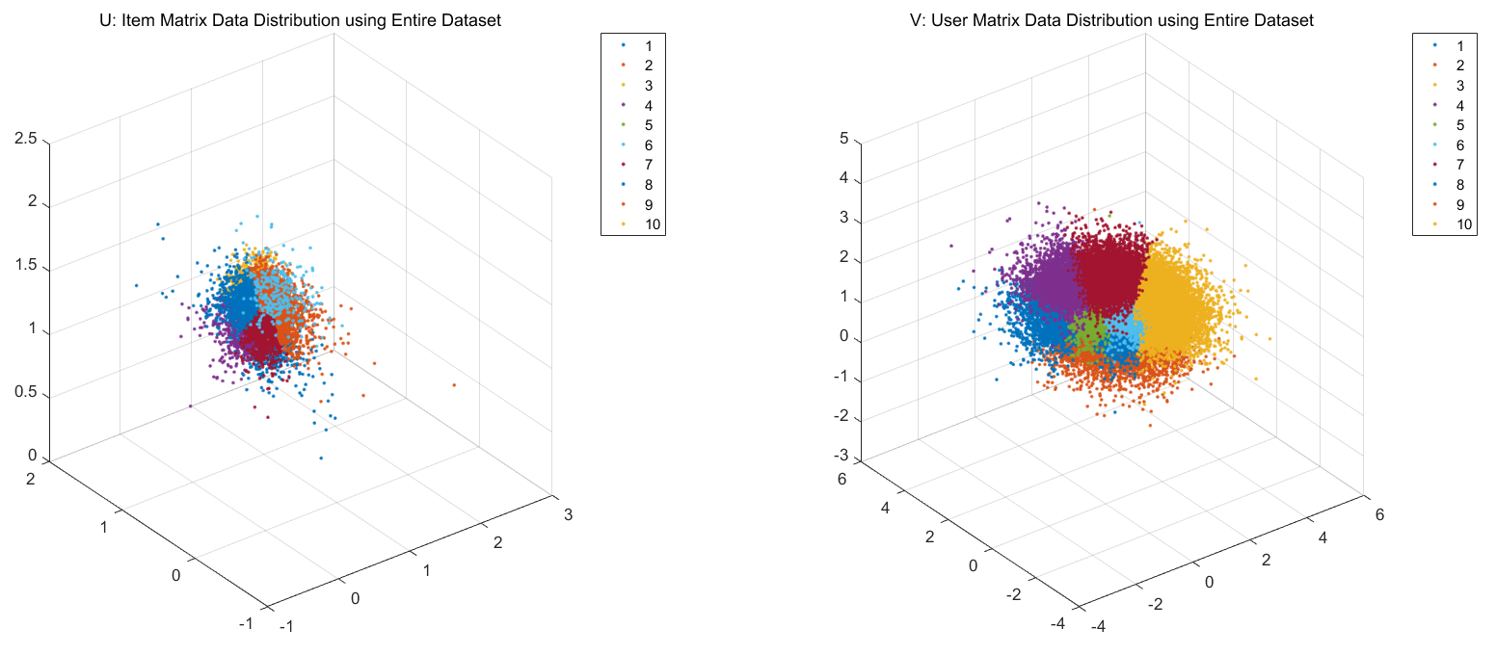
Result on Entire Dataset

Slide 32
Result and Conclusion
05

Slide 33
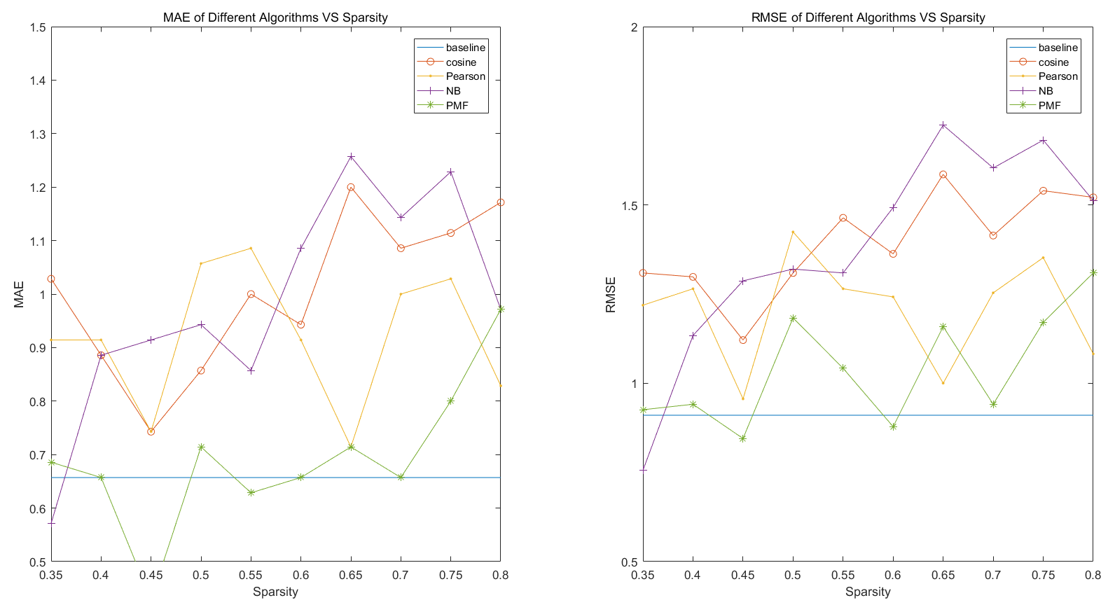
Result on 10 Small Datasets

Slide 34
Result on Entire Dataset
 | MAE | RMSE
Baseline (with Mean Value 4) | 0.7757 | 1.0324
Cosine Similarity | 0.8260 | 1.1911
Pearson Correlation | 0.8575 | 1.1876
Naive Bayes | 1.4744 | 1.8572
Probabilistic Matrix Factorization | 0.6989 | 0.9940

Slide 35
Conclusion
Sparsity will affect the results of some algorithms.
For most cases Naive Bayes CF gives the worst prediction. However, it also gives a best prediction with the smallest sparsity.
For most cases PMF model gives the best prediction, best running time with the price of using largest memory size.
MNAR: Rating are missing not at random problem.
Missing data mechanism cannot be ignored.

Slide 36
Thanks!

Slide 37
Q & A?

